Slide 1

MACHINE LEARNING PROJECT
Team members
Kasma Marianna
Tsekouras Ilias
Tsiolis Spyridon

Slide 2
Argumentation mining
Data Annotation
Data pre-processing
Classification
Clustering
Discussion/Comments

Slide 3
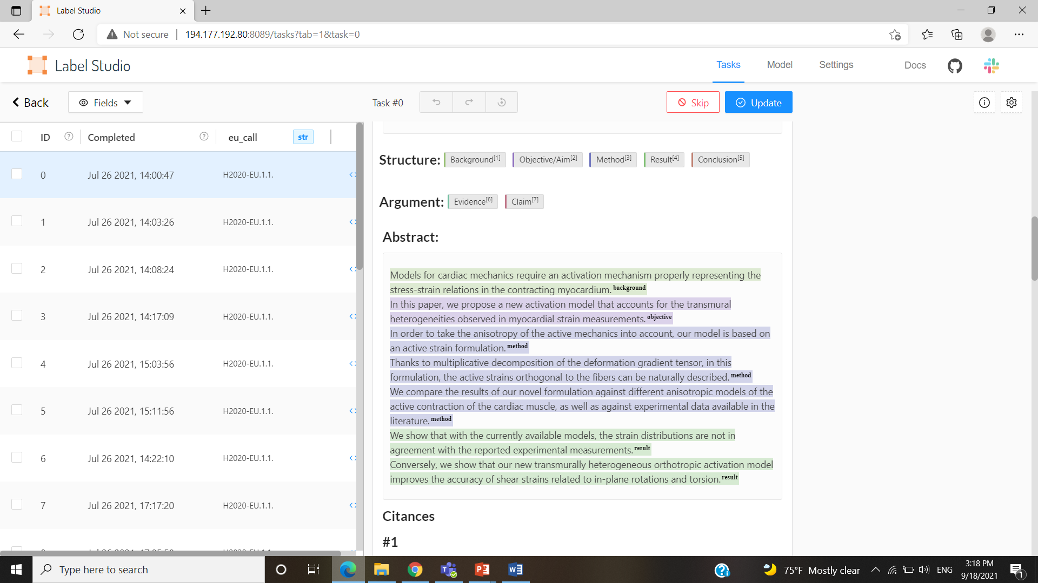
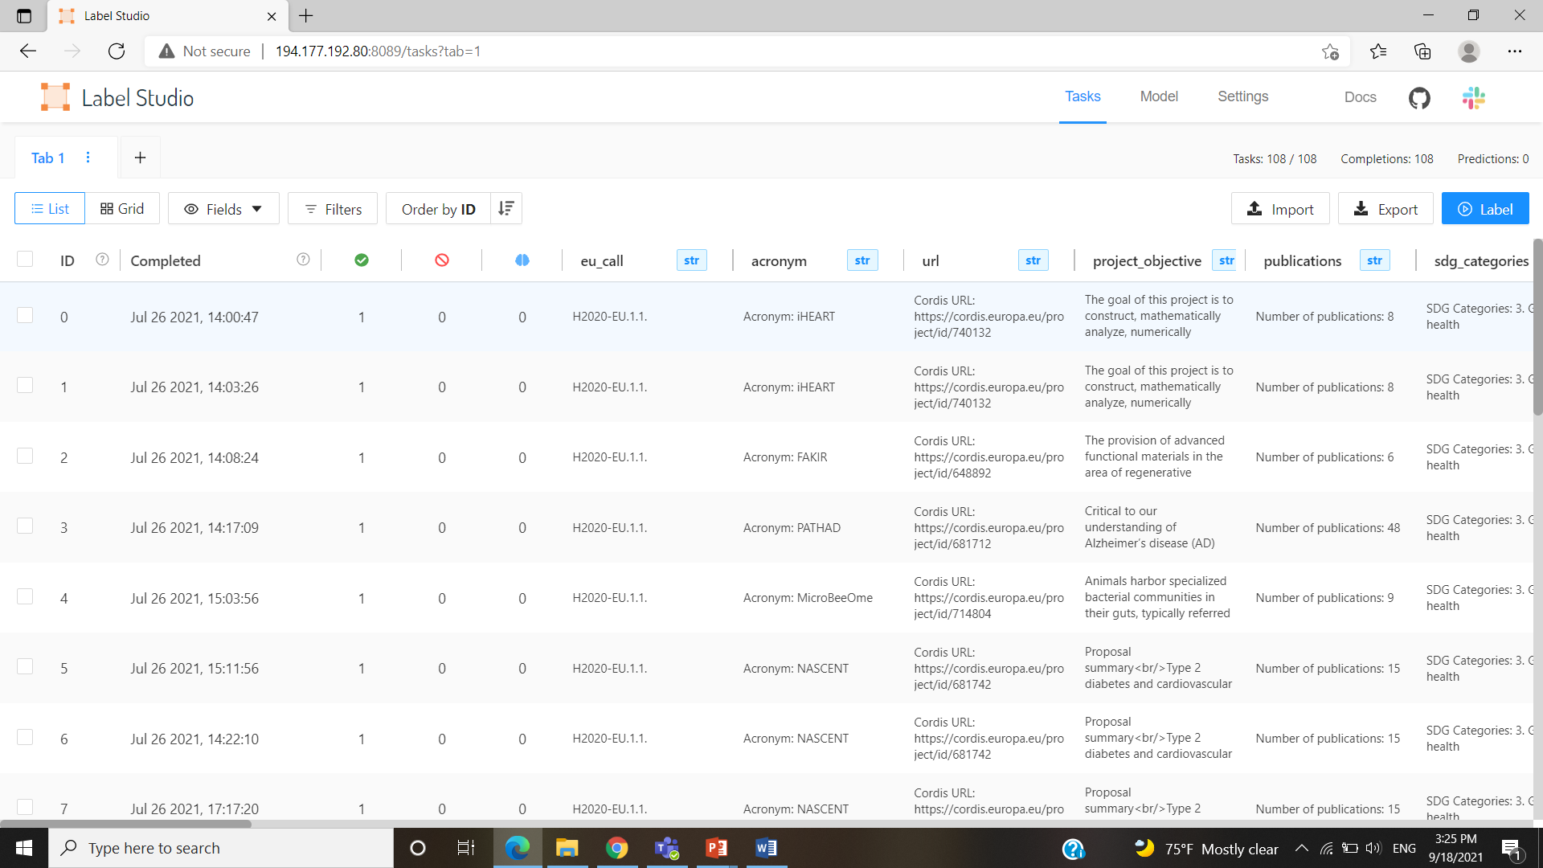
DATA ANNOTATION
Data Source: Horizon 2020
Gathered abstracts originated from different scientific fields, concerning environmental, biomedical and other scientific researches.
or ‘Neither’
Data Labeling Tool:

Slide 4
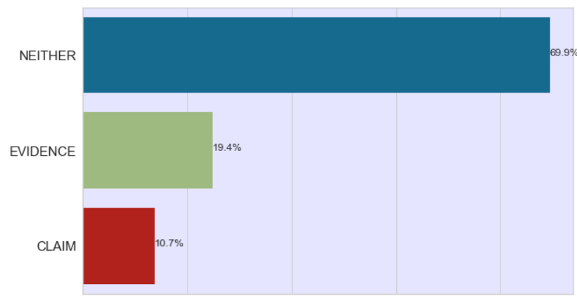
DATA OVERVIEW
2686 Abstracts
32004 Sentences
22375 ( Neither )
6210 (Evidence)
3419 (Claim)

Slide 5
DATA PRE-PROCESSING
Removed punctuation marks
Split sentences into tokens
Removed stopwords and digits
Lemmatized verbs and nouns
Padding length sequences
Split into train-test sets
One-hot encoding of the labels
Tokens into sequence of number

Slide 6
CLASSIFICATION
TWO CNN MODELS
MODEL SUMMARY
Sequential Model
Embedding Layer
Dropout Layer
Convolutional Layer
GlobalMaxPooling
Dense Layer
1st : Custom Created Embeddings
2nd : Pre-Trained Embeddings (GloVe)

Slide 7
CLASSIFICATION
1st Model
2nd Model
Confusion Matrix
Label | Neither | Evidence | Claim
Neither | 6094 | 491 | 128
Evidence | 797 | 1018 | 48
Claim | 594 | 182 | 250
Confusion Matrix
Label | Neither | Evidence | Claim
Neither | 6304 | 284 | 125
Evidence | 994 | 820 | 49
Claim | 666 | 98 | 262
Accuracy Score : 76.7%
Accuracy Score : 76.9%

Slide 8
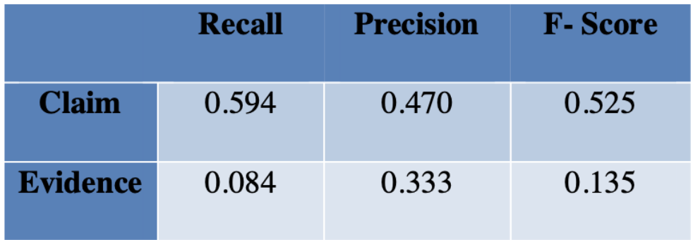
CLASSIFICATION
BASELINE MODEL
CREATION
RESULTS
Word Lexicons
Claim ( provide, confirm, suggest etc.)
Evidence (results, findings, etc.)
Label all last sentences as claim

Slide 9
CLUSTERING
Approaches
1st: Using Abstract Embeddings
2nd: Using only Claim Embeddings
Models
Word2Vec
Glove

Slide 10
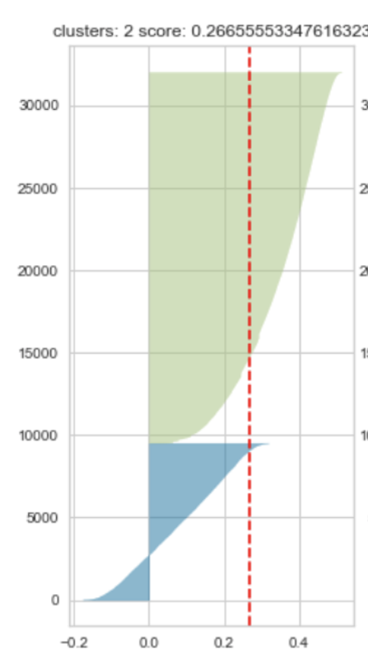
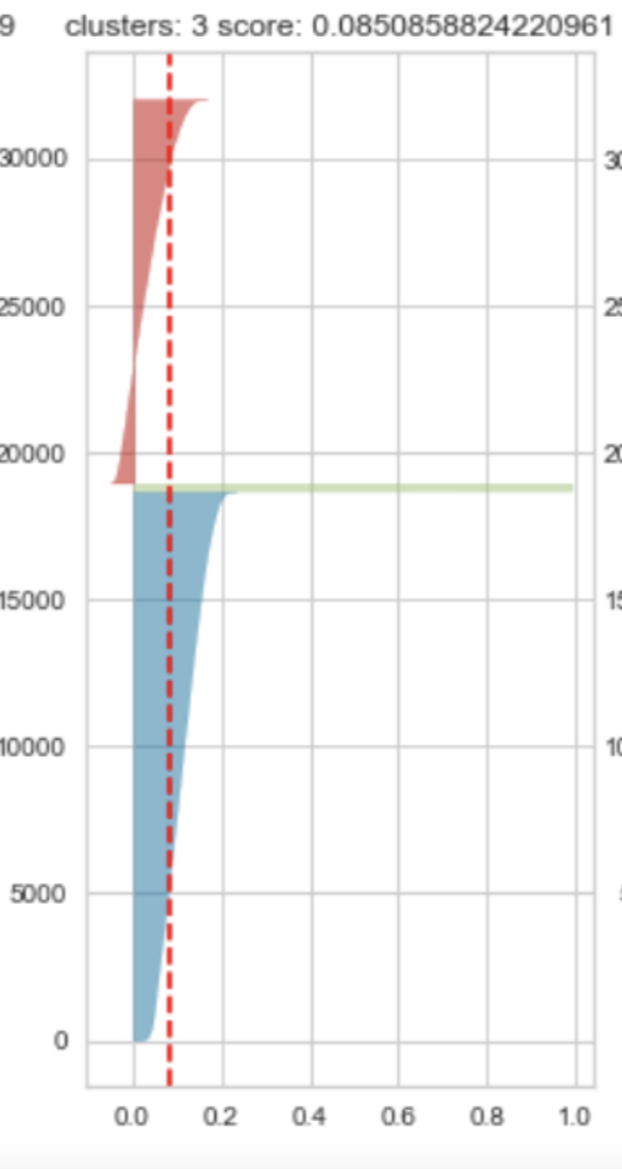
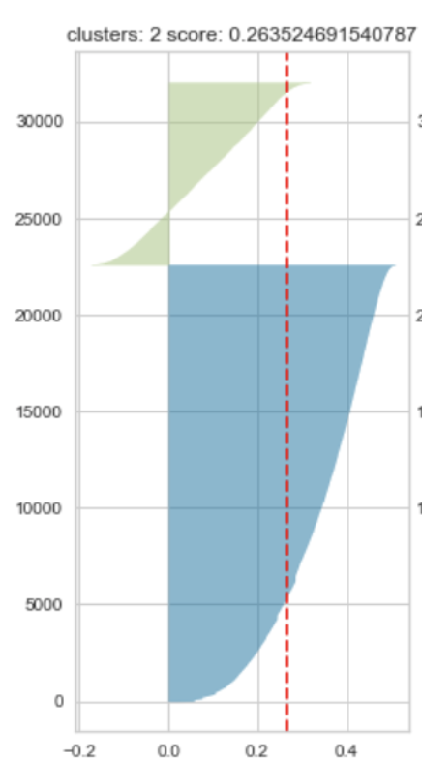
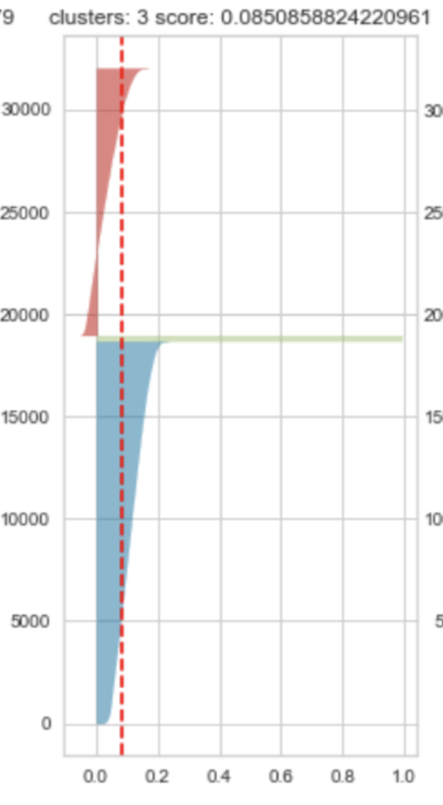
CLUSTERING
Abstract – Word2Vec
Abstract – GloVe
K = 2
Silhouette val = 0.26
K = 3
Silhouette val = 0.08
Claim – Word2Vec
Claim – GloVe
K = 2
Silhouette val = 0.26
K = 3
Silhouette val = 0.08

Slide 11
DISCUSSION/COMMENTS
More attributes to be used in the future in our clustering
Silhouette Values close to zero
Compared to the dummy classifier we observed only 10% improvement in our models

Slide 12

Thank you for your attention!
Any Questions?

